Slide 1
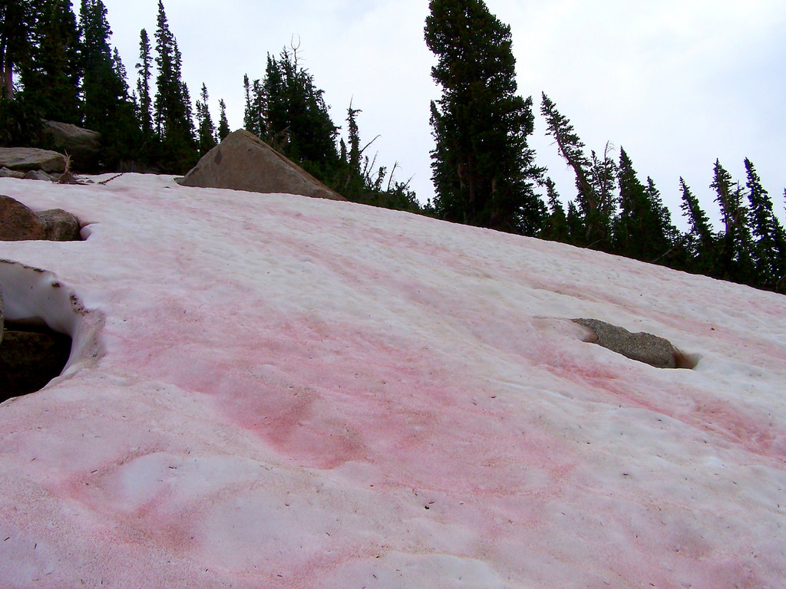
Kodner Lab at WWU has observed patches of pink snow in the spring and summer.
Watermelon Snow
by Bryant Olson

Slide 2
So, the scientists at Kodner Labs asked...
“How does the pink snow get
on top of the snow in the spring
and summer?”

Slide 3
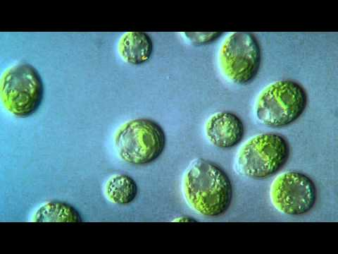
Snow Algae: Chlamydomonas nivalis

Slide 4
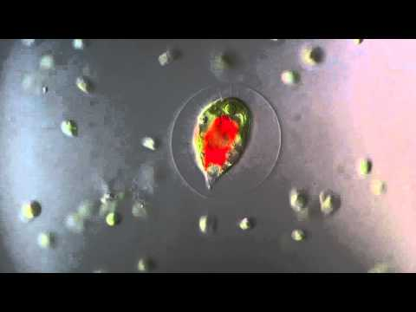
Snow Algae: Chlamydomonas nivalis

Slide 5
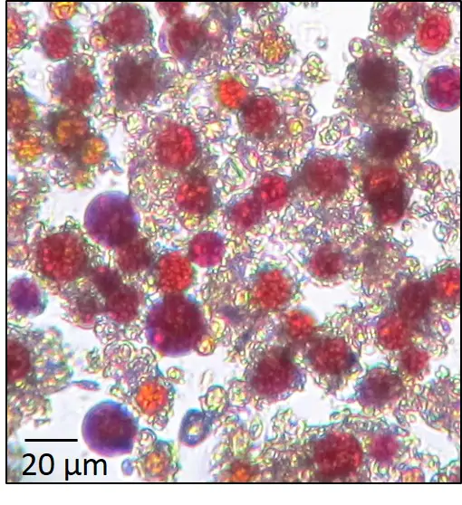
Snow Algae: Chlamydomonas nivalis
The red algae under
a microscope.
(Stefanie Lutz/GFZ)

Slide 6
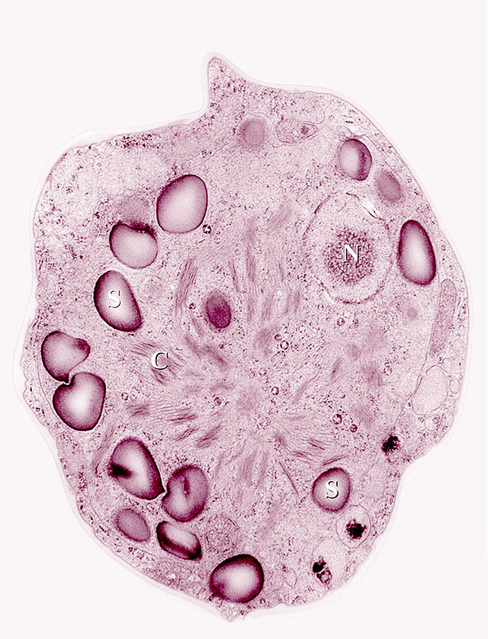
Snow Algae: Chlamydomonas nivalis
higher magnification:

Slide 7
Snow algae can and does change between the two forms--red and green.
Red algae = dormant cysts (inactive)
Green algae = flagellated swimmers

Slide 8
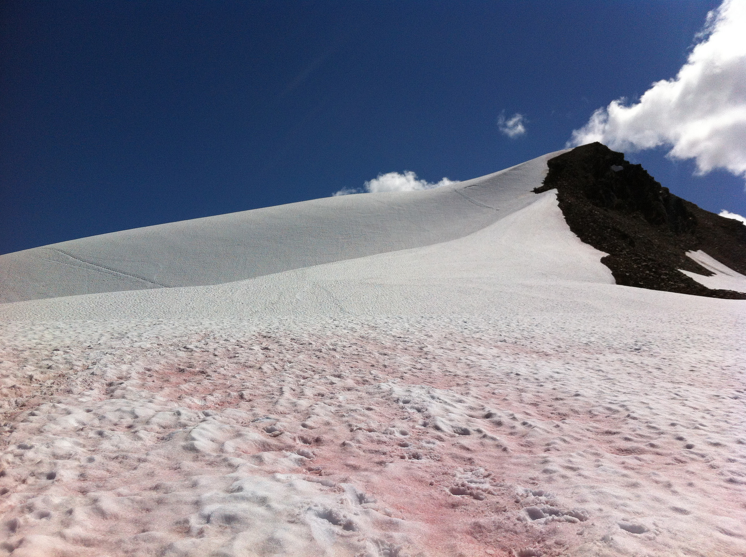
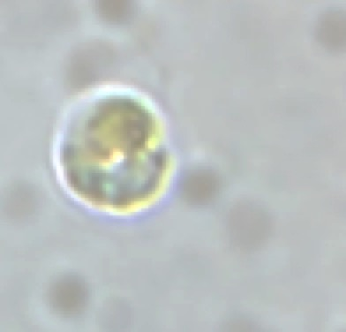
Two Hypotheses:

Slide 9
snow algae (unknown sp.) Bagley Lakes – Early June 2017

Slide 10
Dispersal Hypothesis 1: Just keep swimming…
fall/winter
spring/summer
summer
summer

Slide 11
snow algae (unknown sp.) Bagley Lakes – Early June 2017

Slide 12
Dispersal Hypothesis 2: Wind
fall/winter
spring/summer
summer
summer

